Slide 2

Sharing good practice
“Every teacher needs to improve, not because they are not good enough, but because they can be even better.”
Dylan Wiliam

Slide 3
Sandringham Six Twilight CPD 2017 - 18
Core Strand
Integrating character through the curriculum
Outstanding Learning
Maximising our KS3 curriculum
Prioritising Pastoral
Brilliant Basics
Mindful Marking
Coaching
Research Strand
Research School Innovation Project

Slide 4
Sandringham Teach Meet 18
Theme | Speakers | Theme | Speakers
Brilliant Basics | Lucinda Archer - Jones Jo MacGregor, Katrin Hood Teresa Strydom | Outstanding Learning | Karen Hay Nicole MacNeil
Prioritising Pastoral | tbc | Research Projects | Gallery from all participants
Maximising our KS3 Currculum | Thom Leat Andy Cracknell
Cracking Character | Hannah Cracknell Stuart Kemp | @Sandagogy
Mindful Marking | Ann Meager Katie Beddoe

Slide 5
Professional Development Summary 2017-18
To accompany your CPD file of evidence
Useful reminder of breadth of our professional learning offer
Links with discussion for appraisal target setting in September/October. Identify if you have any specific training needs.

Slide 6
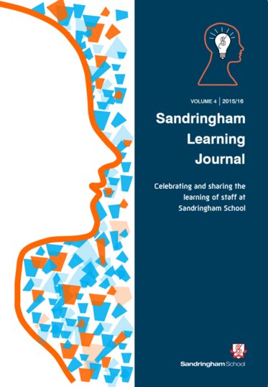
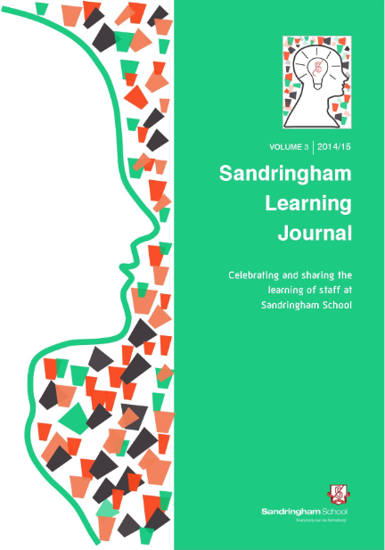
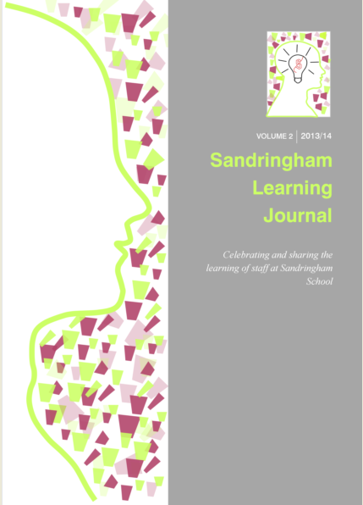
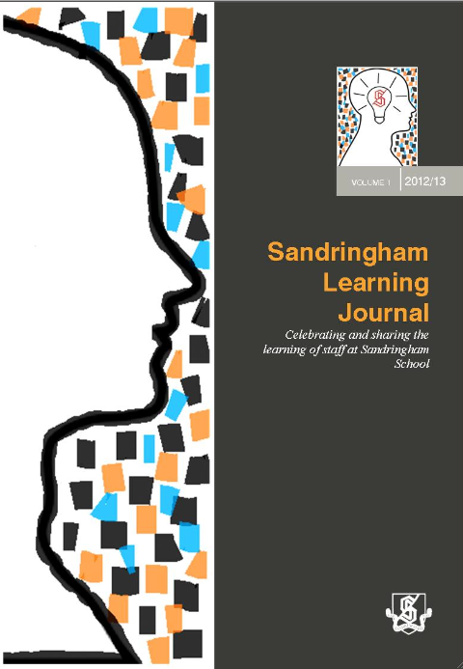

Sandringham Learning Journal
Volume 6

Slide 7
Dame Alison Peacock, Chartered College of Teaching
This Learning Journal provides a microcosm of the professional learning culture that I believe we need to experience at scale. I read the journal from cover to cover one Sunday morning enjoying the wide range of contributions, all of which are written in a brisk compelling style, ideal for the busy teacher. The Chartered College of Teaching seeks to build a collective ambition for teachers that celebrates the agency borne out of enquiry, reflection and debate with a central mission of providing the best possible learning opportunities for children and young people. This spirit shines out of the Sandringham Learning Journal - congratulations!

Slide 8
David Waters, Assistant Headteacher, St.Georges School
A fascinating collection of articles. All equally worthy in their own way, but what drives a common purpose in each is not only the importance of reflection, but also the desire to keep improving. What is it that catalyses this process of change? Reading Alan Gray’s thoughtful article on self-evaluation, particularly through his exploration of Professor Hopkins’ ideas, I was reminded of the importance of leadership throughout the school, of teacher agency. Building on this, James Cracknell and Graeme Swann’s insights spoke volumes: passion for subject, the ability to inspire and shape young minds, the need to refocus on our core purpose as teachers. This echoes an important national conversation, which is clearly embedded in myriad ways, in this journal.”

Slide 9
Athena Pitsillis, Head of English, Canons High School
I am truly blown away by the sheer amount of work of so many colleagues who have taken time to write about their experiences: the good, the bad and the funny! It is so clear from reading these accounts that the students are at the forefront of decision-making at Sandringham and it is impressive to see how much work is going on in the school. In reading through I have had so many reactions; from nodding my head in agreement, giggling to myself and even taking notes of key research findings. As a new member of staff joining the school in September, it has been invaluable at providing me with a better insight and understanding of what goes on at Sandringham day-to-day, month-to-month and across the year…and it is highly impressive!

Slide 10
Have a lovely summer!
Notes:
CPD certificates
Course booklets
Thank yous
Articles
Evidence of student work
Graphs
Copy of appraisal etc

