Slide 1
KQ: Can I closely analyse a quotation?
3rd May 2018

Slide 2
Oh! But he was a tight-fisted hand at the grindstone, Scrooge! a squeezing, wrenching, grasping, scraping, clutching, covetous, old sinner! Hard and sharp as flint, from which no steel had ever struck out generous fire; secret, and self-contained, and solitary as an oyster. The cold within him froze his old features, nipped his pointed nose, shriveled his cheek, stiffened his gait; made his eyes red, his thin lips blue; and spoke out shrewdly in his grating voice. A frosty rime was on his head, and on his eyebrows, and his wiry chin. He carried his own low temperature always about with him; he iced his office in the dog-days; and didn’t thaw it one degree at Christmas.

Slide 3
Similes
Simile = a comparison using ‘as’ or ‘like’.
Example: Grandpa lounged on the raft in the middle of the pool like an old battleship.

Slide 4
In the extract we read last lesson, two similes were used to describe Scrooge.
Look at the first simile – what is Scrooge being compared to?
“secret, and self-contained, and solitary as an oyster.”
Scrooge is being compared to _______________________________

Slide 5
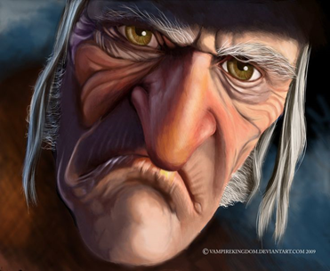
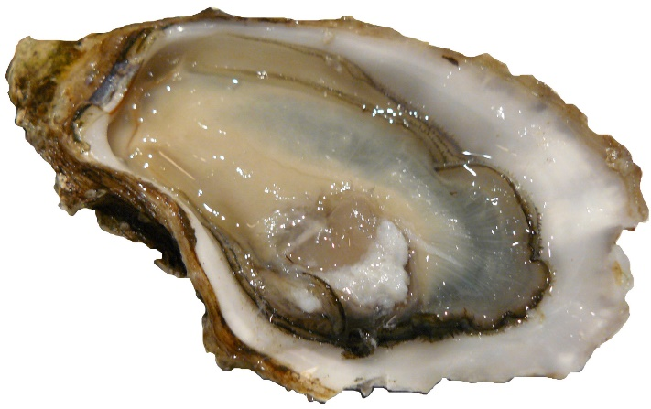
Now let’s consider, why the comparison is being made.
Look at the two pictures below and consider the similarities between the two.
HINT: Think about the word ‘solitary’ and think about the word ‘oyster’.
“As solitary as an oyster”

Slide 6
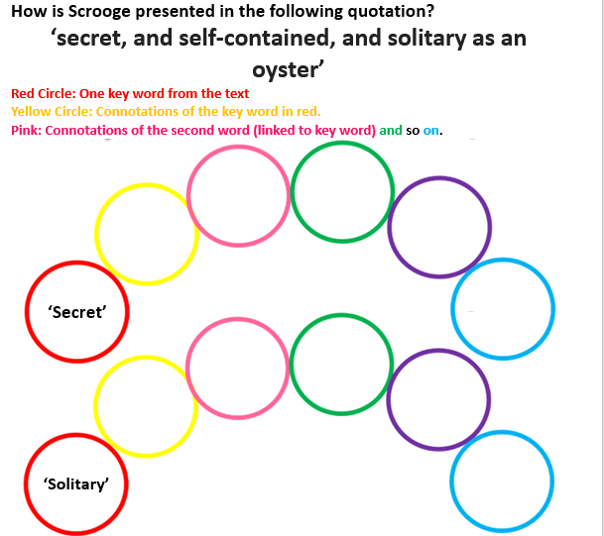

Slide 7
hidden
quiet
silent
unknown
Unseen
unspoken
hiding
isolated
alone
sole
unsociable

Slide 8
Write up your analysis using the rainbow word analysis.
P: When we are first introduced to Scrooge, Dickens uses {name the technique} to describe him as … {include Quotation}
A: Use the analysis phrases and the rainbow word analysis to closely analyse the quotation.
Analysis phrases
This suggests that…
There is a sense of…
This may be associated with…
This could represent…
Dickens makes it sound…
This sets up the idea….
This word implies…

Slide 9
My example
When we are first introduced to Scrooge, Dickens uses a simile to describe him as “as secret, and self-contained, and solitary as an oyster.” This suggests that Scrooge silently hides away from others. There is a sense that he is quiet and is unsociable. The word ‘secret’ implies that there is something unknown, maybe even unspoken, about Scrooge.
Analysis phrases
This suggests that…
There is a sense of…
This may be associated with…
This could represent…
Dickens makes it sound…
This sets up the idea….
This word implies…

Slide 10
Hard and sharp as flint

